Slide 1
Non-Linear classification
Chunyang Wei

Slide 2
Review
Notes:
KNN??
NN??

Slide 3
Today’s Outline
Decision Tree
Random Forest
Neural Network
K-NN

Slide 4
Decision Tree

Slide 5
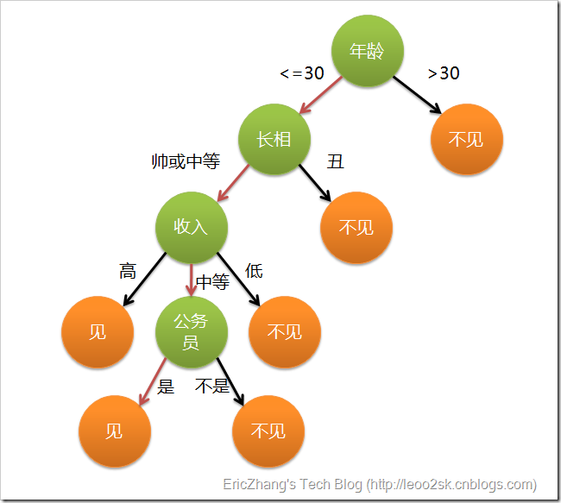
Basic Idea
“If-else Rule”
Classical Algorithm:
ID3,C4.5,CART

Slide 6
How to build the Tree
Top-down recursive procedure
Greedy Search
Main loop:
1. Select a feature F best classifies examples
2. Create a node using F, separate the data set with different values of F
3. Recursively build sub-tree
4. Stop until:
The examples have the same category: build a leaf node with this category
The feature set is empty: build a leaf node with the most common category
ID3 Algorithm
Notes:
画一颗示意过程的树动画

Slide 7
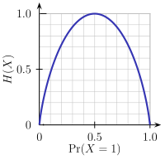
Feature Selection
Pick a feature that has the best classification ability.
Creates subsets of examples that are relatively “pure” in a single class.
Information Gain
Entropy
Gain(X,A) = expected reduction in entropy due to spliting on A
Notes:
熵表示随机变量的不确定性，熵越大，随机变量的不确定性越大。
熵表示了编码有这样概率分布的样本，需要的最少平均每个样本的bit是多少
如果所有样本都属于同一个分类，熵为0.
信息增益表示的值特征A的信息而使得D的不确定性的减少程度。
其中H(D|A)称为条件熵，表示在已知A的情况下，随机变量D的不确定性
H(D)=-\sum_{i=1}^n{p_i\log{p_i}}
Gain(D,A)&=H(D)-H(D|A)\\
&=H(D)-\sum_{v\in Values(A)}{\frac{|D_v|}{|D|}H(D_v)}

Slide 8
C4.5
Use Gain Ratio to select feature
Notes:
C4.5克服了ID3用信息增益选择属性时偏向选择取值多的属性的不足
那些取值比较均匀的Feature的splitInfo比较大，信息增益比比较小
GainRatio(D,A)=\frac{Gain(D,A)}{SplitInformation(D,A)}
SplitInformation(D,A)=-\sum_{i=1}^n{\frac{|D_i|}{|D|}\log\frac{|D_i|}{|D|}}

Slide 9
Overfitting

Slide 10
When to use decision tree

